Slide 1
Lecture 10
Network Emulators vs Network Simulators
Mininet

Slide 2

Six people who see an elephant from six different angles will give you six different descriptions of the size and shape of that elephant!

Slide 3

But a single person who looks at that same elephant from all six different perspectives instead will be able to piece together all of his observations and eventually arrive at the only reasonable conclusion!
ODL
RYU
OVS
SDN
POX
Open Flow
Mininet

Slide 4
Network simulation or emulation?
As a network engineer, an improperly configured application can cost a whole lot of time and money down the line
The best way to try and prevent these unfortunate accidents is by conducting thorough and efficient testing on a routine basis
Whether designing a network, migrating to the cloud, or adding a new device to the rack, every step within the application deployment life cycle should be validated with accurate testing

Slide 5
Network simulation or emulation..
Regarding network testing, the terms emulation and simulation are often used interchangeably
A simulator can perform tasks in abstract to demonstrate the behaviour of a network and its components, while an emulator can copy the behaviour of a network to functionally replace it

Slide 6
Network simulators
On a basic level, a network simulator uses mathematical formulas to create a theoretical and entirely virtual model of a network
Simulators are software solutions and different types are available for different applications
Used primarily for research and educational purposes
Simulators, such as ns-3, Packet tracer, ensp are used to simulate networking and routing protocols.
These simulators allows network architect or engineer to build and evaluate an experimental model of a network, including its topology and application flow
Since a variety of theoretical scenarios can be introduced to a network where anything can be built and applied, performance can be hypothesized before the network itself has even been implemented within the real-world

Slide 7
Network emulators
A network emulator is used to test the performance of a real network
These devices can also be used for such purposes as quality assurance, proof of concept, or troubleshooting
Available as hardware or software solutions, a network emulator allows network architects, engineers, and developers to accurately gauge an application’s responsiveness, throughput, and quality of end-user experience prior to applying making changes or additions to a system
Mininet , GNS 3 are example of such network emulators

Slide 8
Mininet
Mininet provides network emulation opposed to simulation, allowing all network software at any layer to be simply run as is
Mininet creates scalable (up to hundreds of nodes, depending on your configuration) software-defined (e.g. OpenFlow) networks on a single PC by using Linux processes in network namespaces
Build in Stanford University.

Slide 10
Wouldn’t it be great if...
We had a simple command-line tool and/or API that did this for us automatically?
It allowed us to easily create topologies of varying size, up to hundreds of nodes, and run tests on them?

Slide 11
www.mininet.org

Slide 12
Native Installation from Source
Open terminal
su root
apt-get update
change home directory
cd /home
apt-get install mininet
clear the controller
mn –c
apt-get install git

Slide 13
git clone https://github.com/mininet/mininet
cd mininet
git tag
git checkout -b cs214
cd ../
mininet/util/install.sh –a
sudo mn

Slide 14
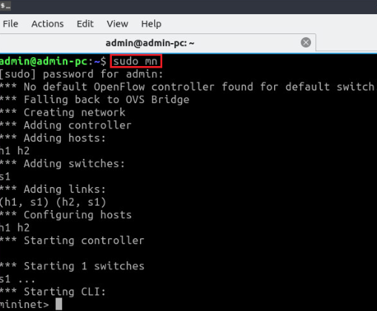
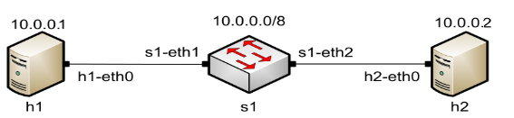
Starting Mininet using the CLI
To start a minimal topology, enter the command sudo mn at the CLI

Slide 15
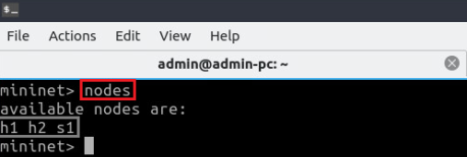
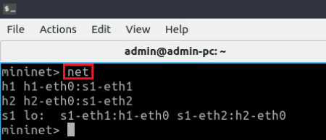
Useful Commands
To display the available nodes, type nodes
To display the links between the devices, type net

Slide 16
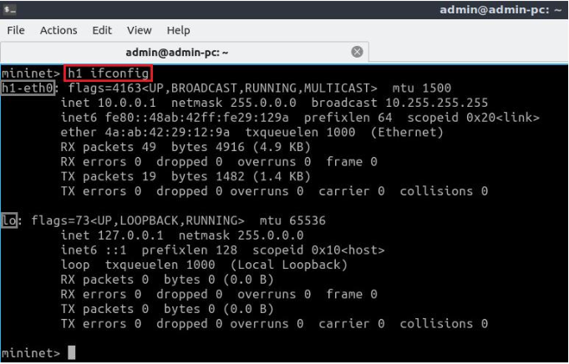
Useful Commands
To execute commands at a specific device, type the device first, followed by the command
For example, to execute the command ifconfig on host h1, type h1 ifconfig

Slide 17
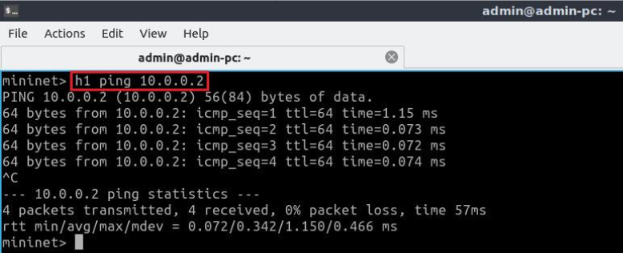
Useful Commands
To test connectivity between end-hosts, use the ping command.
Type h1 ping 10.0.0.2 to test the connectivity between host h1and host h2 (10.0.0.2)

Slide 18
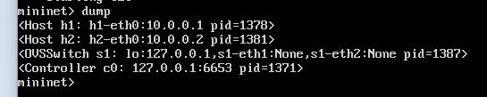
Useful Commands
> dump • Dump information about all nodes

Slide 19
Building and emulating a network in Mininet using the GUI

Slide 20
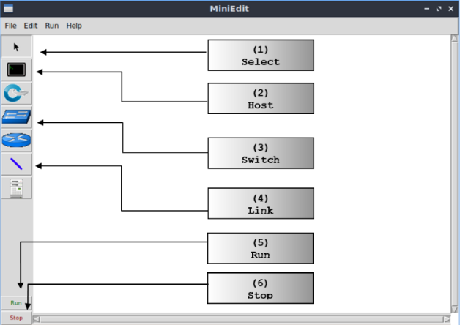
MiniEdit
MiniEdit is a simple GUI network editor for Mininet
sudo python3 mininet/examples/miniedit.py

Slide 21
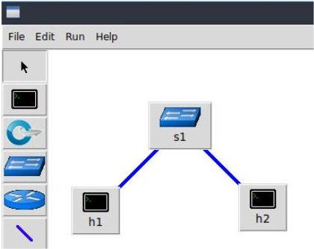
MiniEdit
To build Mininet’s minimal topology, two hosts and one switch must be deployed

Slide 22
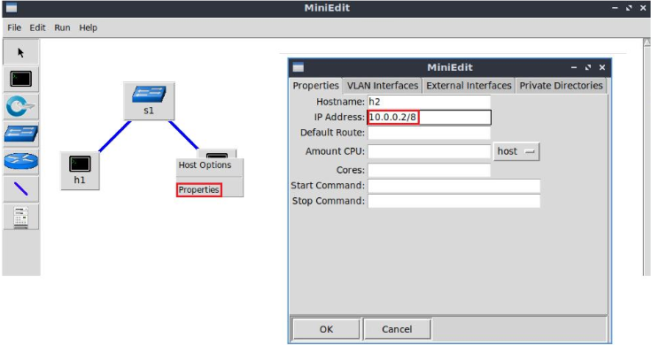
Host Configuration
Configure the IP addresses at host h1 and host h2
A host can be configured by holding the right click and selecting properties on the device

Slide 23
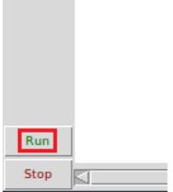
Starting Emulation
Before testing the connection between host h1 and host h2, the emulation must be started
Click on the Run button to start the emulation
The emulation will start and the buttons of the MiniEdit panel will gray out, indicating that they are currently disabled

Slide 24
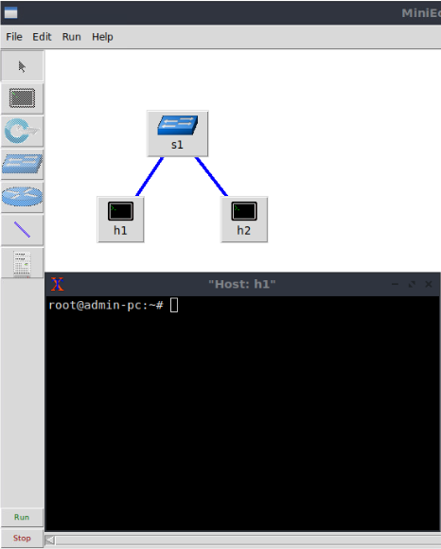
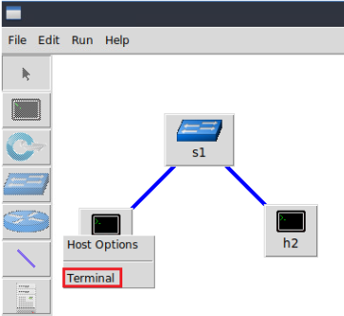
Executing Commands on Hosts
Open a terminal on host by holding the right click and selecting Terminal

Slide 25
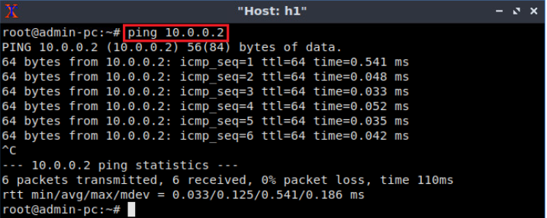
Testing Connectivity
On host h1’s terminal, type the command ping 10.0.0.2

Slide 26
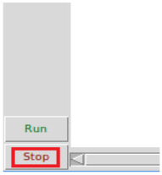
Stopping Emulation
Stopping the emulation removes:
Network namespaces (nodes)
Virtual interfaces
Links between switches and hosts
Stops the virtual switches instances
Stop the emulation by clicking on the Stop button

Slide 27
Iperf
IPerf is an open-source command line tool designed to test network throughput between two network hosts.
The iPerf allows to generate TCP and UDP traffic (load) between two hosts.
You can use iPerf to quickly measure the maximum network bandwidth (throughput) between a server and a client, and conduct stress testing of the ISP link, router, network gateway (firewall), your Ethernet, or Wi-Fi network performance.
set bandwidth and delay for the link :
sudo mn --link tc,bw=10,delay=10ms

Slide 28
Creating custom topology
> sudo mn -- topo single,4 • 4 hosts connected to single switch
> sudo mn --topo linear,4 • 4 hosts connected to 4 switches in linear topology
• Writing python scripts to create your own topology > mn --custom myTopo.py --topo mytopo

Slide 29
Creating custom topology
mn --mac • Assigns linearly increasing MAC Addresses to hosts • h1: 00:00:00:00:00:01 • h2: 00:00:00:00:00:02 • so on…
> xterm h1 • Allows X11 forwarding and can provide a window with an access to host’s/switch’s terminal
For fault tolerance testing, it can be helpful to bring links up and down:
link s1 h1 down

Slide 30
Mininet Remote Controller
sudo mn --controller=remote, ip=[controller IP],port=[controller listening port]
Use your own controller (Ryu, POX, NOX)
Explore Mininet’s Documentation and Walkthroughs

